Slide 1
Mini Search Engine
xxx
Notes:
简单，多样，正确

Slide 2
Content
Section #1
Section #2
1
Introduction
2
Data Structure Algorithms
Section #3
Section #4
3
4
Analysis
Testing Result

Slide 3
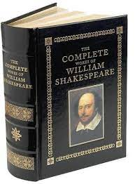
Introduction
Task:
Constructing a Mini Search Engine for “The Complete Works of William Shakespeare”
Requirement:
Word Stem & Stop Word
Inverted index
Words and phrases searching
Threshold query
Input : word/phrase
Output: IDs of the documents that contain the word

Slide 4
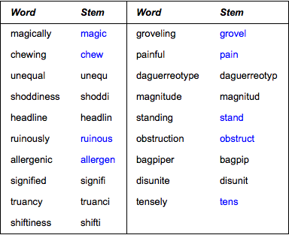
Introduction
Word Stemming
A word stem is the base or root form of a word, obtained by removing any affixes such as prefixes or suffixes.
Realized by third-part code porter2_stemmer

Slide 5
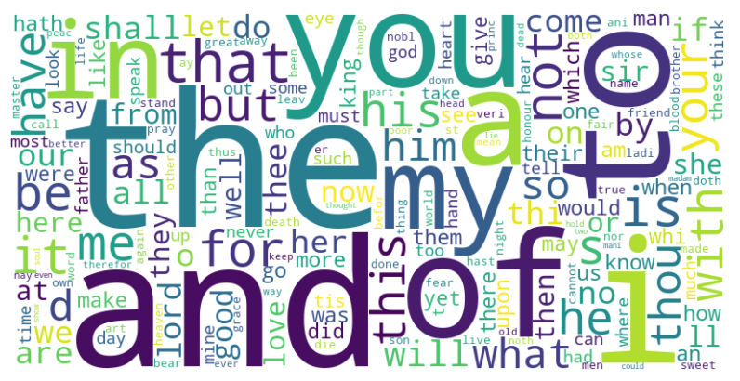
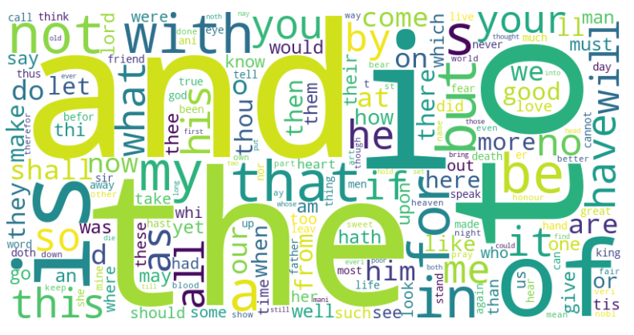
Introduction
Stop Words
Some words are so common that almost every document contains them, such as "and“ "the", which is useless to index.
We could eliminate these Stop Words from the document.
Word Cloud by the number of appearance
Word Cloud by the number of article appearance

Slide 6
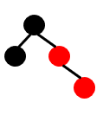
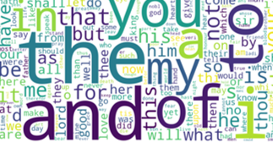

Data Structure Algorithms
Build Dictionary
Find Stop Words
Search

Slide 7
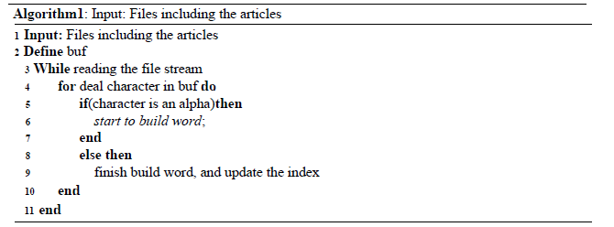
Data Structure Algorithms
Build Dictionary
We conveniently extract words and word frequency from each book, and use red-black trees to create an inverted index.
Notes:
为了确定阈值我们首先按分析了词的分布和增量，发现100后面的词接近收敛，因此我们初始选择了阈值为100

Slide 8
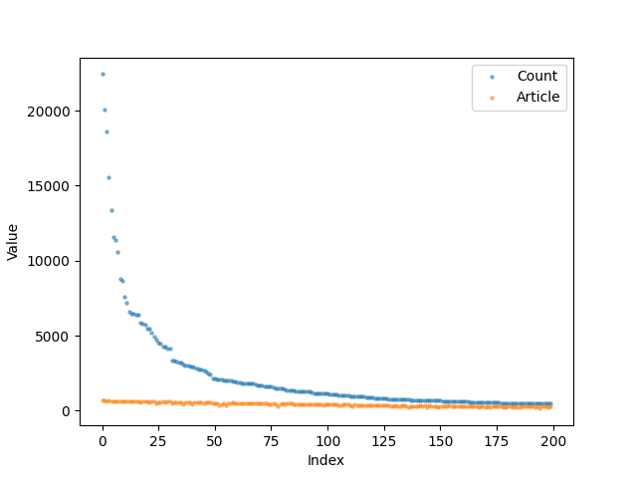
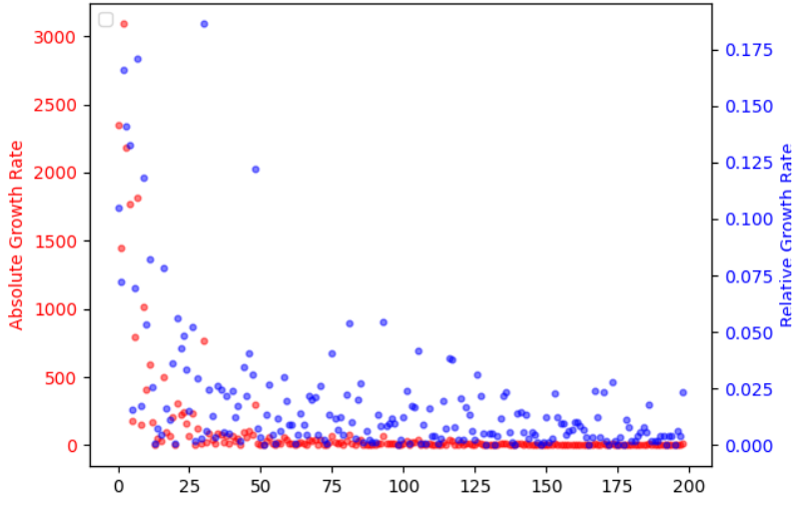
Data Structure Algorithms
Find Stop Words
To determine the threshold, our chief analyst analyzed the distribution and increment of words, finding convergence nearing 100 subsequent words.
Top 200 words number distribution
Top 200 words growth rate
Notes:
为了确定阈值我们首席按分析了词的分布和增量，发现100后面的词接近收敛，因此我们初始选择了阈值为100

Slide 9
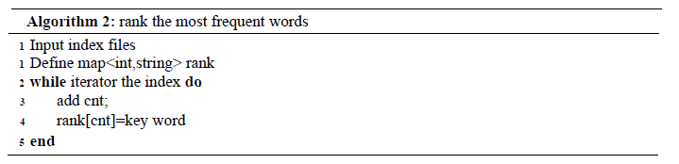
Data Structure Algorithms
Find Stop Words
We choose 100 as the threshold at first

Slide 10
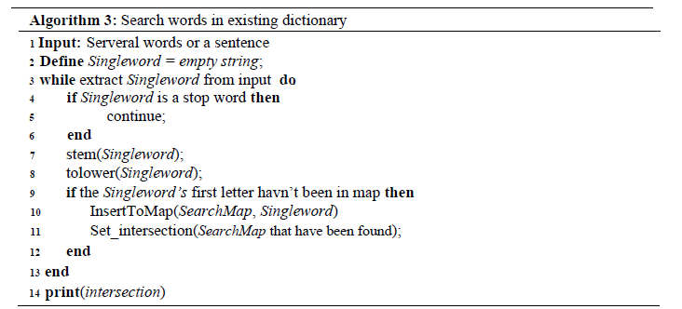
Data Structure Algorithms
Search
Employing methods like stop words removal and hash classification for efficiency improvement, along with intersection search for multiple keywords.

Slide 11
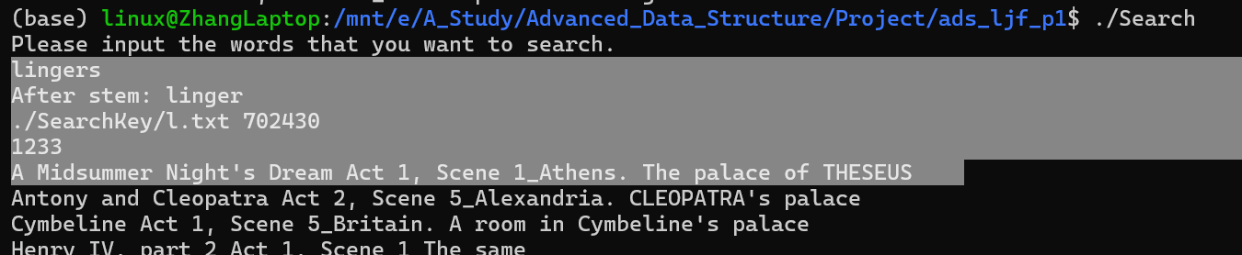
Testing Result
Test single word stemming
We randomly chose some so what unique words to test the search of a single word that needs to stem. Here is a example. We choose “lingers” from “A Midsummer Night's Dream Act 1, Scene 1_Athens. The palace of THESEUS”, whilch is a plural word. And search it using our program. Easily we can find the result is properly stemmed and searched.

Slide 12
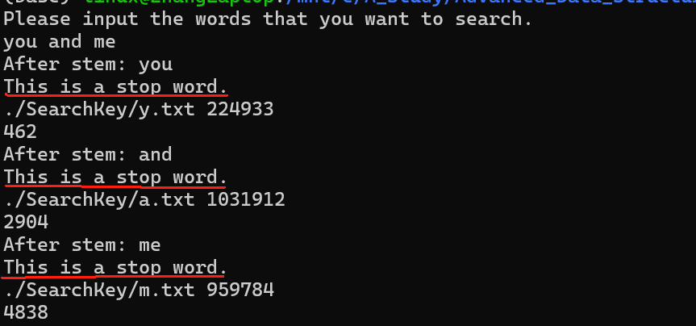
Testing Result
Test stop words
When we input stop word, the program will imform the user that this is an stop word. And it's excluded

Slide 13
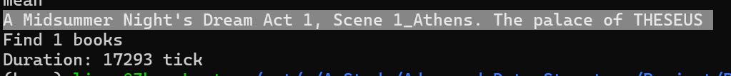
Testing Result
Test words in document
Search “Hermia impression gentleman pilgrimage prosecute nosegays endure daughter right means” in the program
Without Threshold
The program successfully finds the book and uses 17293 ticks.

Slide 14
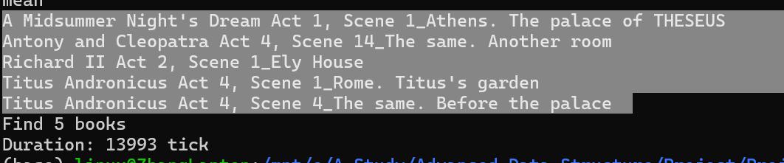
Testing Result
Word in document
Search “Hermia impression gentleman pilgrimage prosecute nosegays endure daughter right means” in the program
With Threshold = 0.2
The program find 5 relative books and uses 13993 ticks.

Slide 15
Testing Result
Word in document
Search “Hermia impression gentleman pilgrimage prosecute nosegays endure daughter right means” in the program
With Threshold = 0.5
The program successfully finds the book and uses 13861 ticks.

Slide 16
Analysis
M is the number of unique words,
N is the number of characters of these files.
M is the number of query words,
N is the unique number of characters
Complexity
N is the number of unique words.
Complexity | Build Dictionary | Stop Word | Search
Time Complexity | O(MN log N), | O(N log N) | O(MlogN)
Space Complexity | O(H) | O(H+N) | O(M+N)
H is the synthesis of the sum of the number of different words in a book
H is the number of different words in a book, N is unique word
M is the number of query words,
N is the unique number of characters

Slide 17
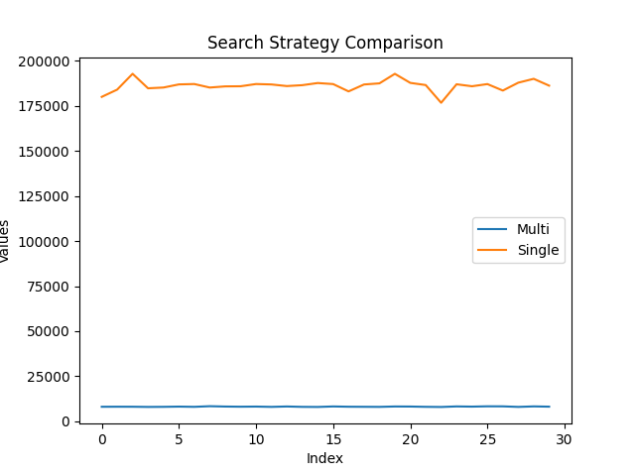
Analysis
Index way
Single:
Index saved in one file
Average: 186228 ticks
Multi:
Index saved in 26 file (i.e. ‘a.txt’,’b.txt’,etc)
About 22.858 times !
Average: 8147 ticks

Slide 18
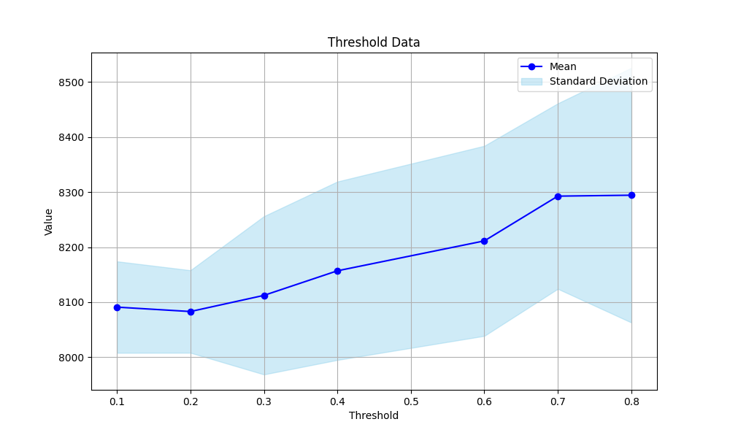
Analysis
Threshold Rate on query
The increase in threshold leads to a gradual increase, but it doesn't increase significantly.
std
mean
Notes:
我们改变Threshold的值，测了十次获得均值和方差，作图后发现，随着Threshold的变大，时间逐渐上升，但是上升的幅度较小。我们猜想是因为频率很高的词本身就很少（而且一部分还被当作Stop Words过滤掉了），因此增大Threshold检索的数量并没有增加太多导致的。

Slide 19
Analysis
Advantage:
· The search time of data is greatly reduced
· Can choose threshold according to your focus in Recall or Precise
Disadvantage
· Haven’t decreased the space complexity in the case of heavy searching.

Slide 20
Appendix
Notes:
简单，多样，正确

Slide 21
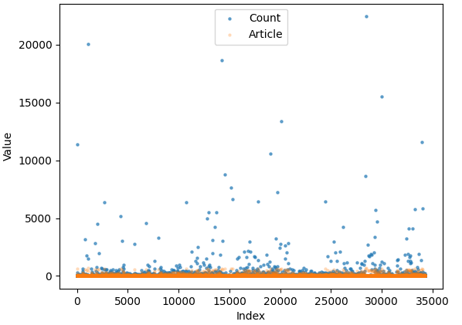
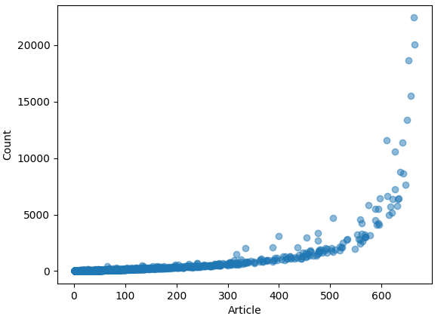
Word Distribution

